Slide 1
Development of Climate Resilience Assessment Toolkits
For Nuclear Waste Management
Zexuan Xu, Erica Woodburn, Haruko Wainwright (MIT), Ken Williams
Satyarth Praveen, Efthymios Nikolopoulos (FIT)
Emily Fabricatore (SRNL), Carol Eddy-Dilek (SRNL)
Notes:
The team is lead by HW, KW, and Carol Eddy-Dilek at SRNL

Slide 2
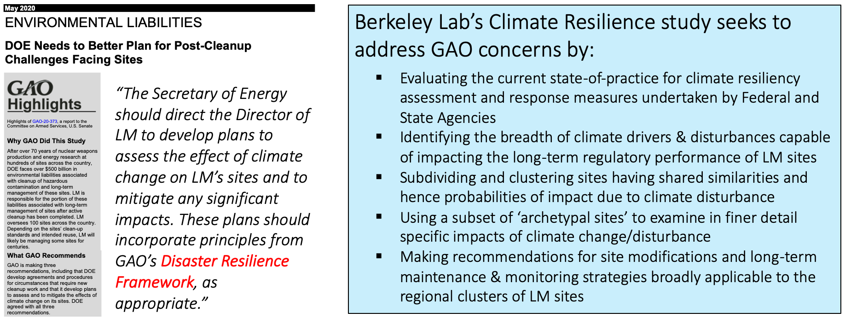
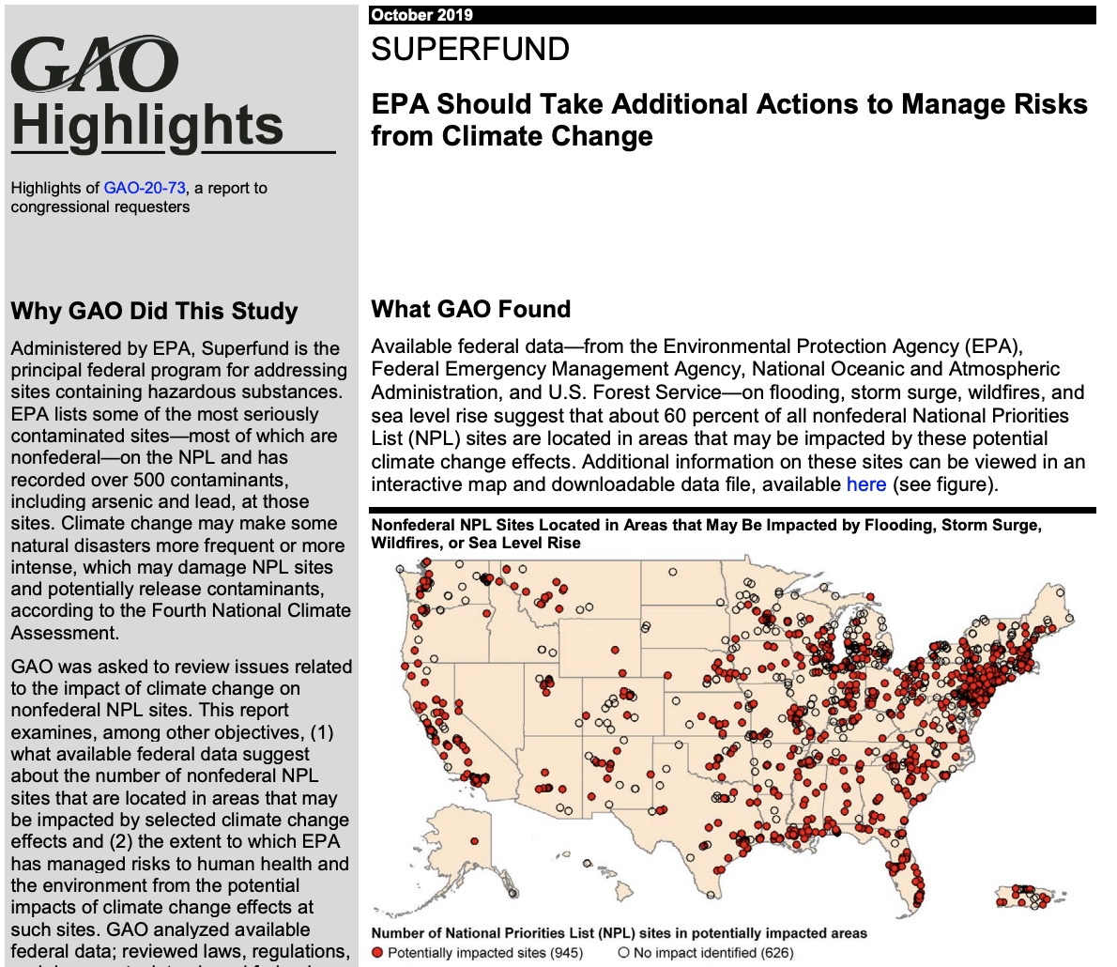
Linking GAO Report to Climate Resilience
Notes:
I want to give a few background of the recent needs of the climate resilience development and assessment to nuclear waste sites
In one of the Government Accountability Office reports, they urge that DOE needs to better plan for post-cleanup challenges facing sites, and address the effect of climate changes on LM’s sites,
Similar requests have been assigned to EPA as well, to manage risks from climate change
As a DOE national lab, We need to develop tool to satisfy the GAO’s requirement to develop climate resilience plan for waste sites

Slide 3
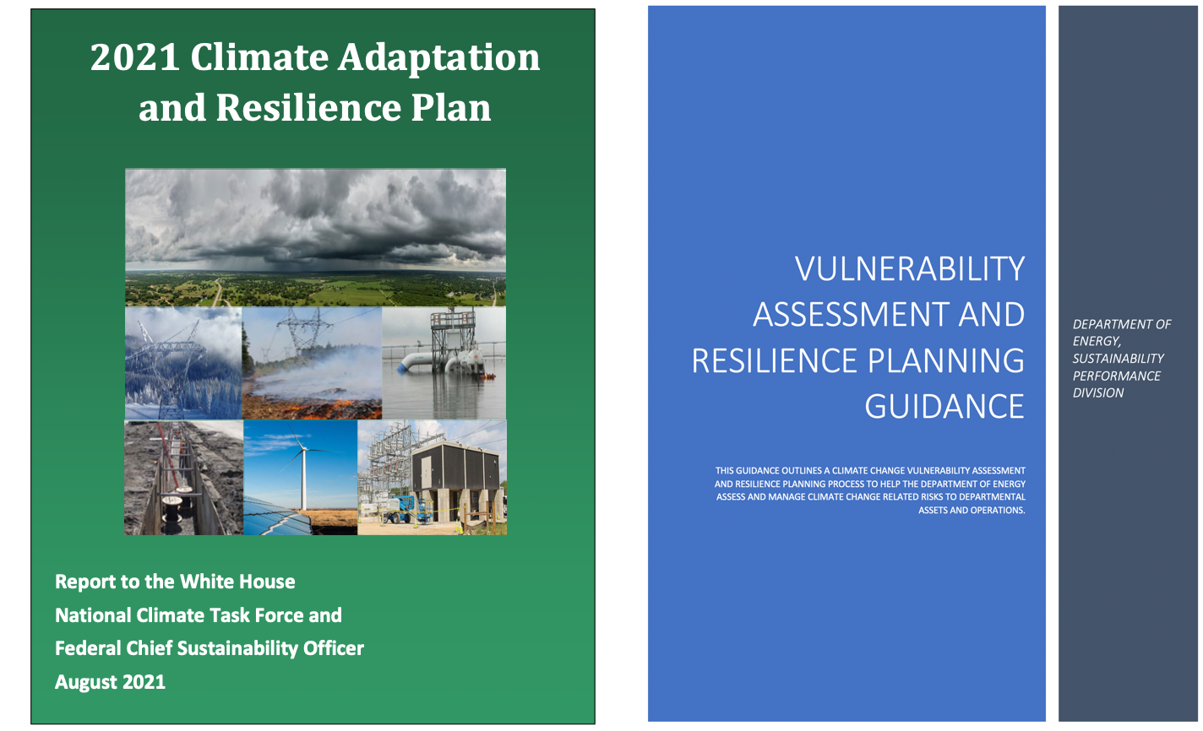
Study’s Relation to DOE’s CARP and VARP Guidelines
Notes:
With these principle, DOE is requesting CARP (...), and VARP (...) work for each LM and EM sites,
We are developing tools to help site managers to complete their VARP requirement.

Slide 4
Climate Resilience: Methodology
Establish an interactive approach between climate science and institutional knowledge for waste management
Analysis of historical climate and its projection
Consistent with to the USGCRP/NCA
Develop open-source python toolsets
Complete transparency: data to visualization
Instant updates as more data/information are acquired
US-wide
Synthesis
Climate Analysis
Institutional Knowledge
Notes:
We are funded by DOE EM and LM offices to complete a climate resilience assessment to nuclear waste sites,
We collected institution knowledge from site manager,
In parallel, we develop the tool for climate change analysis,
Our methodology is required to be consistent with USGCRP,
And we also developed open-source climate tools in python, with complete transparency in data to visualization, and the capabilities of instant updates as more data/information are acquired

Slide 5
Climate Assessment Workflow
Jupyter notebook
Surveys
(assets etc)
Google Earth Engine
CMIP6 daily climate data
(projection)
Site-by-site data selection
Metrics calculation
Climate metric visualization
ERA5 daily climate data
(historical)
Reducer
Maps
Trend/ranges
Site coordinates
Vulnerability
Ranking
Data Retrieval
Data Processing
Final Products
ML of historical data/climate
Vulnerability
probability
Notes:
On the left, we developed tool with google earth engine to automate downloading climate data at the waste site,
On the right, data analytics, calculating climate metrics, generate visualizations and come up with vulnerability ranking
We are also able to integrated with ML models to compute vulnerability probabilities,

Slide 6
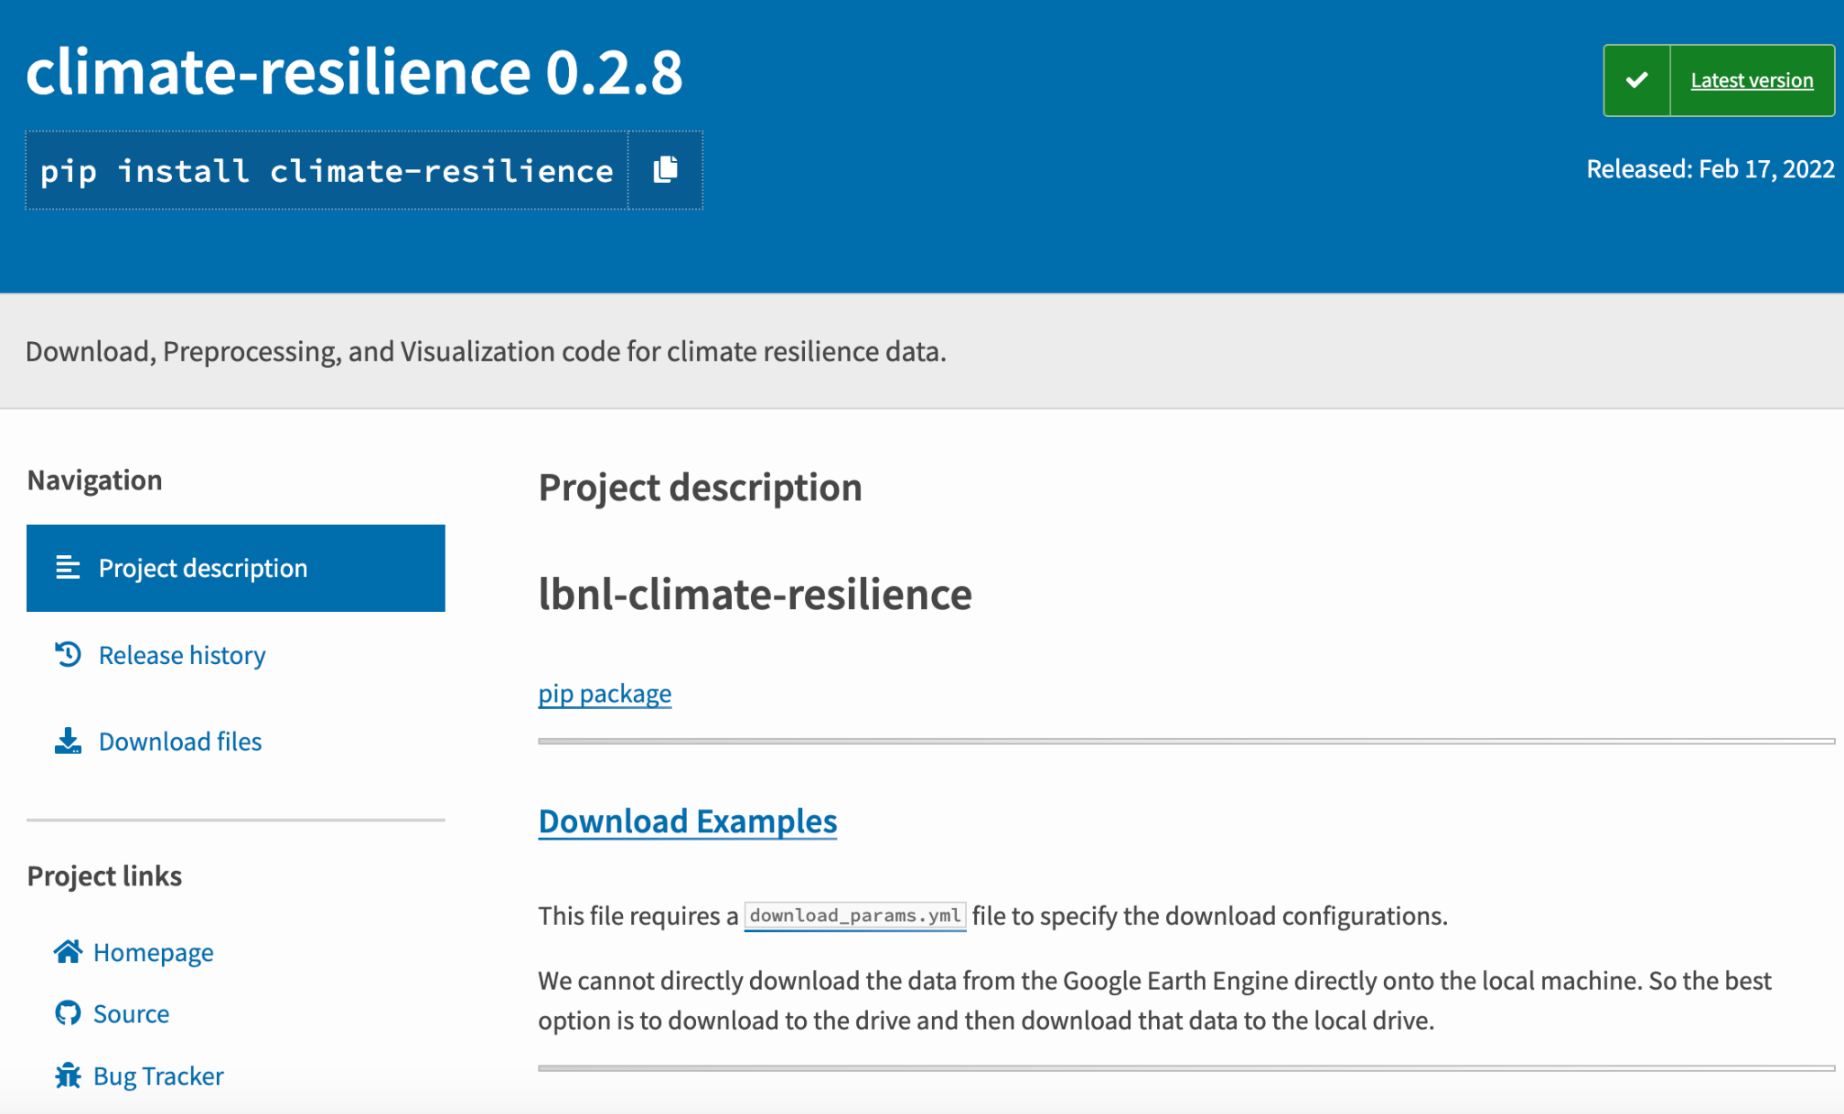
Software; pypi.org/project/climate-resilience
Notes:
Download, visualization Examples,

Slide 7
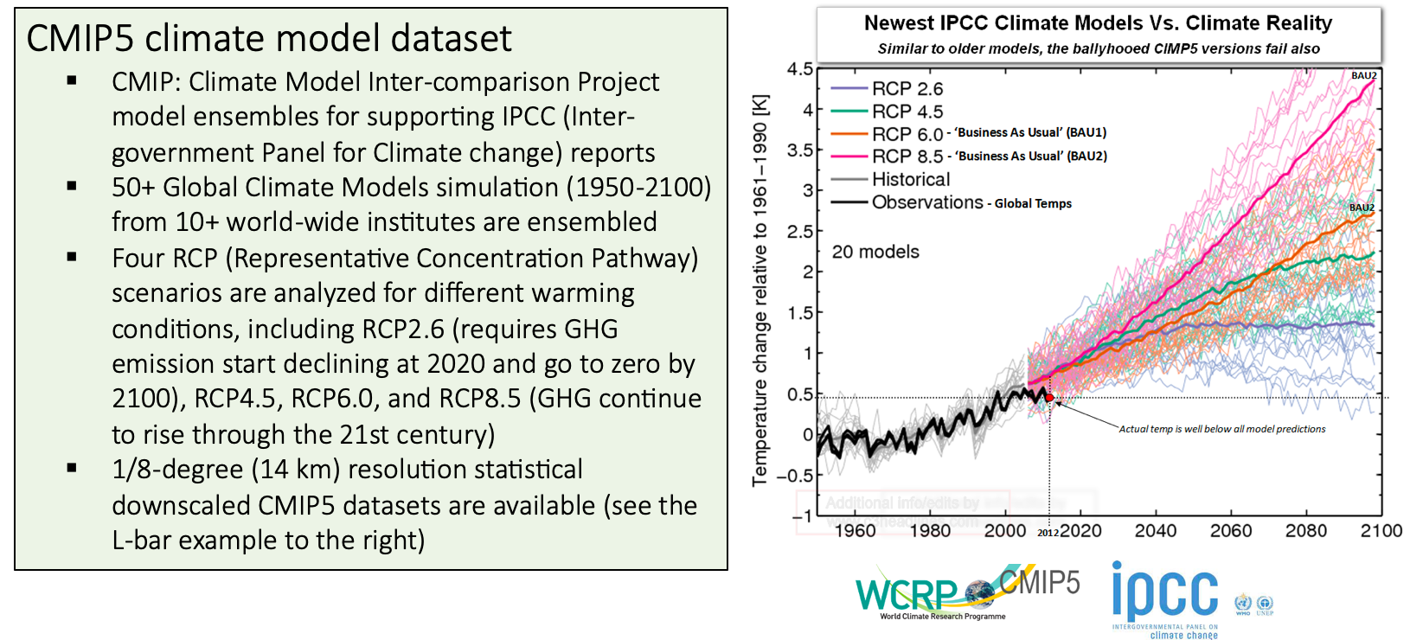
Climate Dataset in Resilience Assessment
Notes:
The datasets we are using is CMIP5, …, which are the same as used for the USGCRP 4th NCA
CMIP5 is an ensemble GCMs developed by more than 10 international research instututes
Four projected scenarios, RCP4.5, RCP 8.5, …

Slide 8

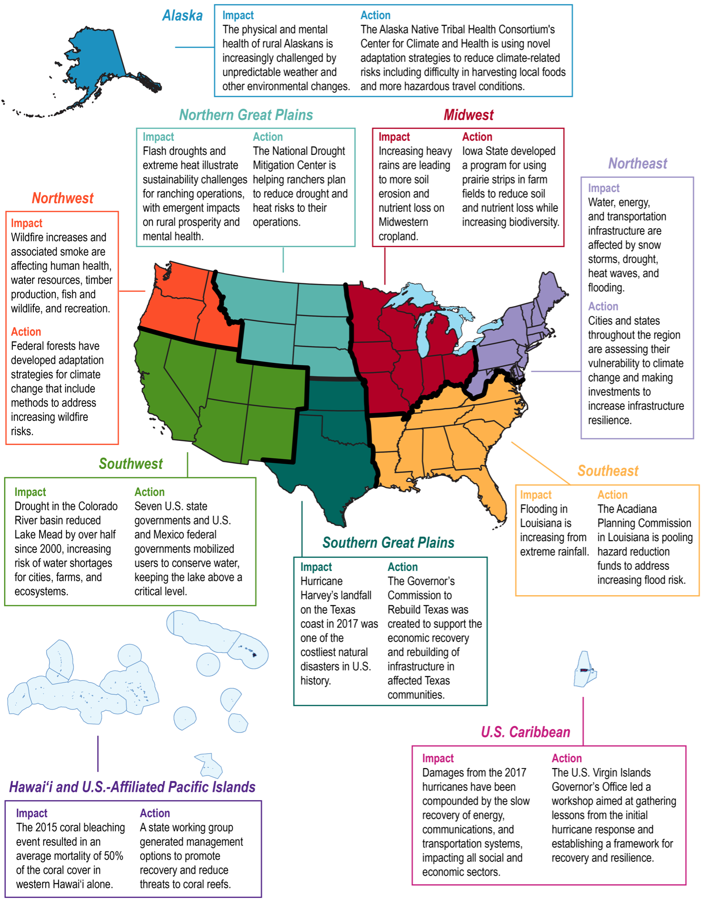
USGCRP National Climate Assessment
4th National Climate Assessment (2017)
Serves as useful template for evaluating observed and future impacts associated with climate change and recommended actions
Utilizes a Regional Approach to subdivide USA
Our climate resilience study relies upon same regional classifications
Our results highlight importance of site-by-site categorization → inter-regional diversity
Notes:
It is worth noting that we are keeping our assessment consistent with the USGCRP, which serves,
We used the same climate scenarios and datasets,
We used the same regional approaches to

Slide 9
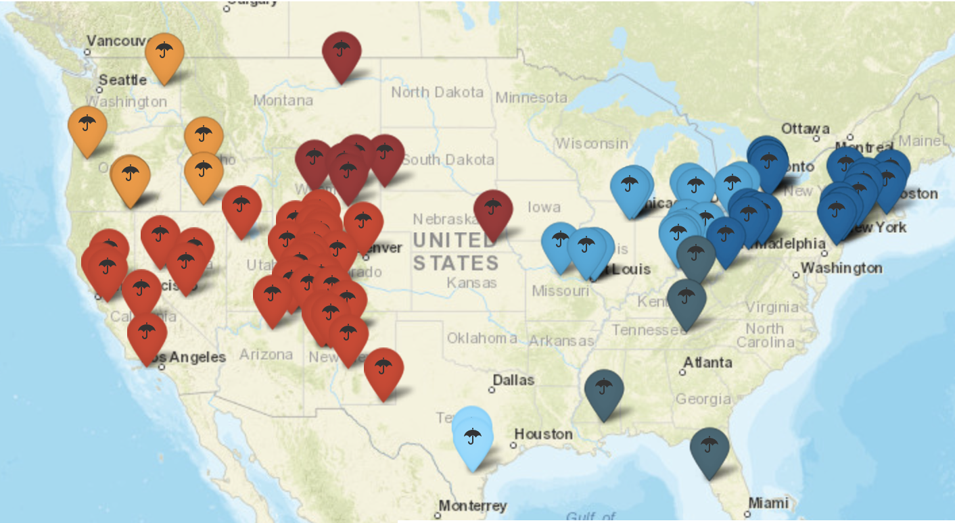
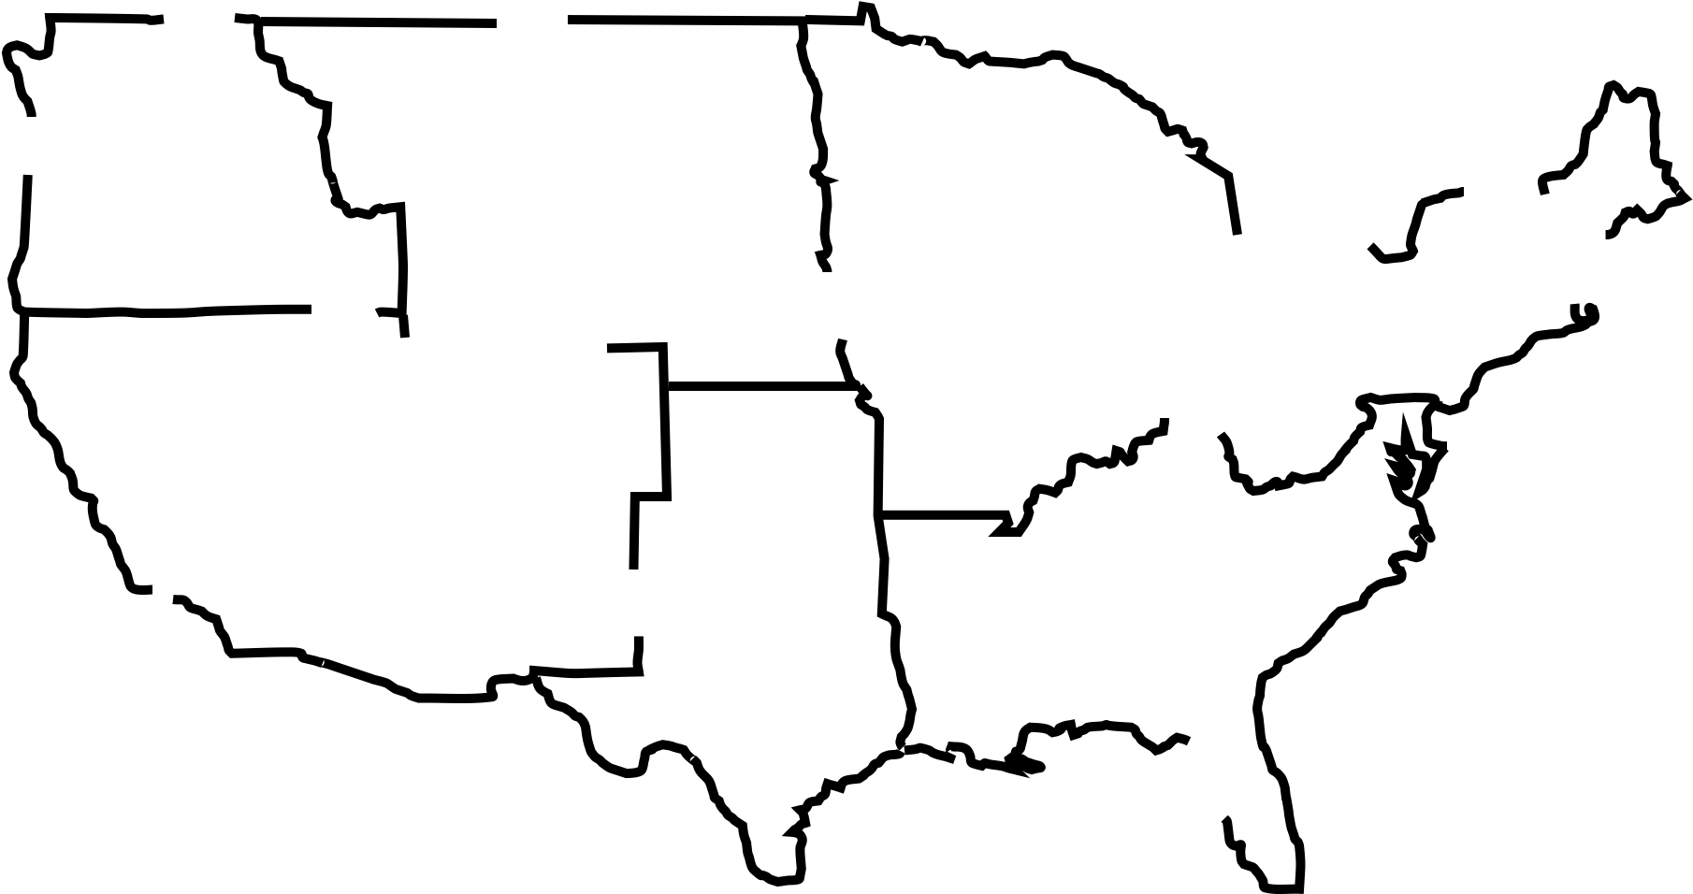
Climate Data/Projections at the LM Sites
Diverse climate and geographical settings
Tropical-to-arid
Coastal-to-inland
Diverse assets
Disposal cells
Active remediation
USGCRP 4th NCA: 9 Regions
Alaska | 2 | Northwest | 6
Caribbean | 2 | S. Great Plains | 2
Midwest | 18 | Southeast | 4
N. Great Plains | 7 | Southwest | 41
Northeast | 20
102 Sites
Two sites in Alaska and two sites in Puerto Rico are not shown in the map
Notes:
As an application, we applied our
More recently, we extend assessment work to the EM sites
In next few slides, you are going to see the changes of climate variables over the 102 LM sites,...

Slide 10
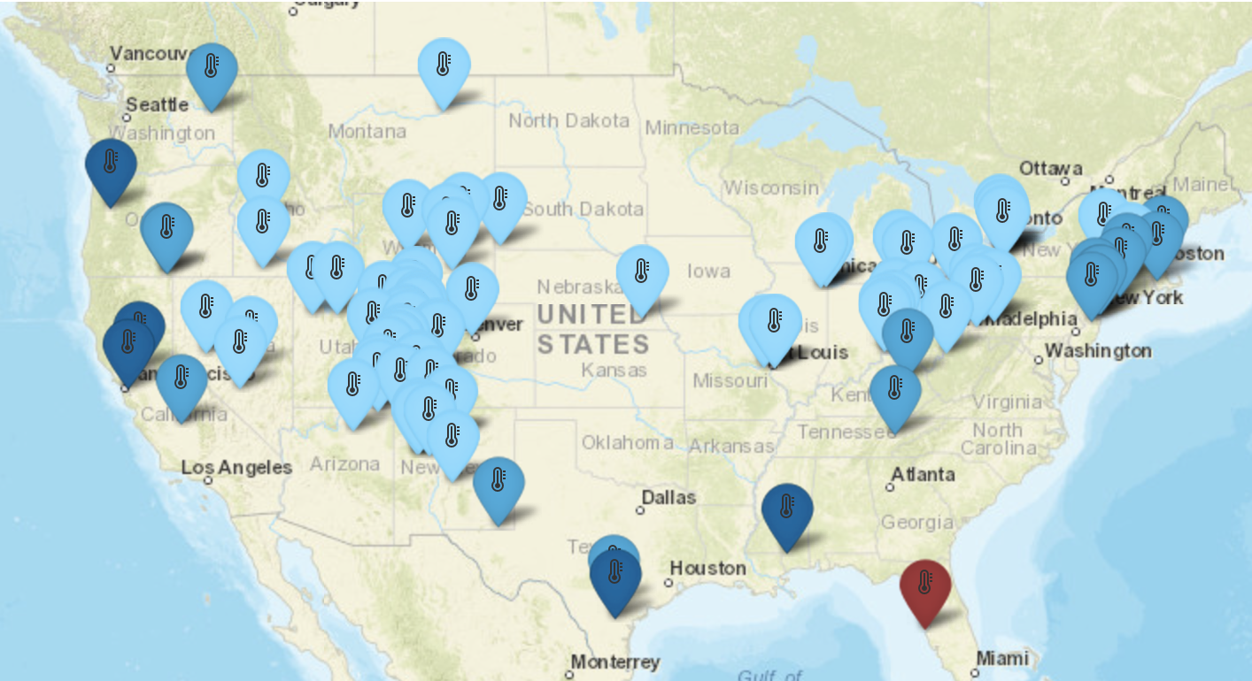
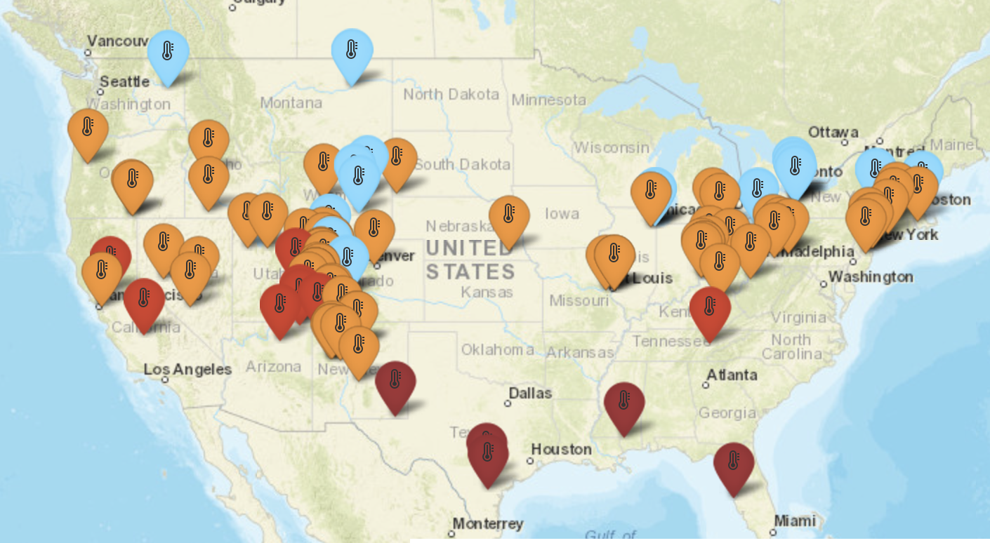
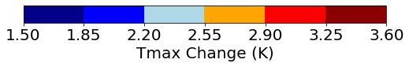
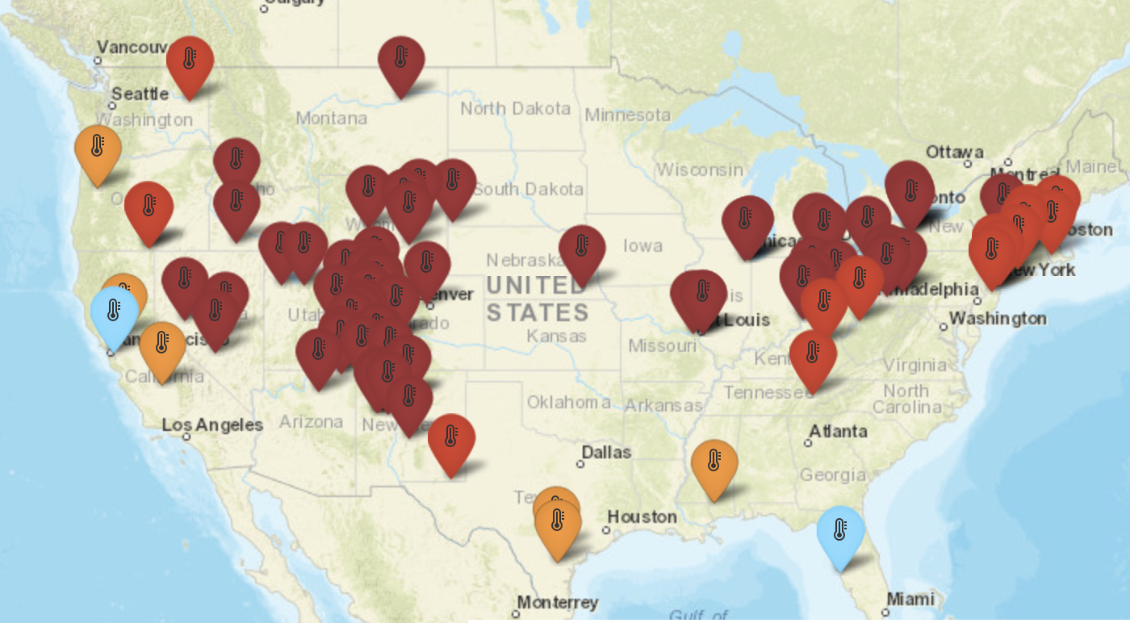
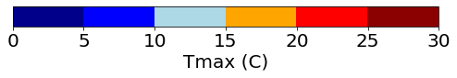
Annual Average Temperature: All Sites
RCP4.5 (2007-2100)
RCP8.5 (2007-2100)
Average over the past 56 years (1950-2006)
Notes:
Left figure = historical 1950-2006; right figures = 2007-2099
Granularity/Variability within each region → site-level assessment is important

Slide 11
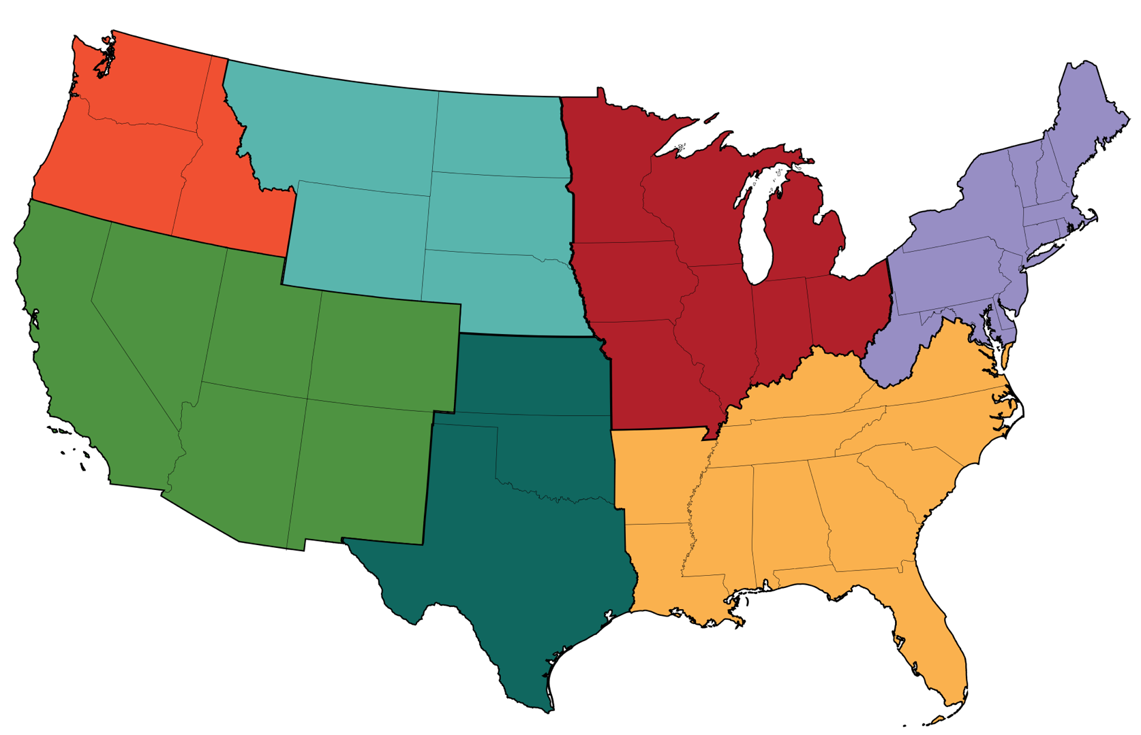
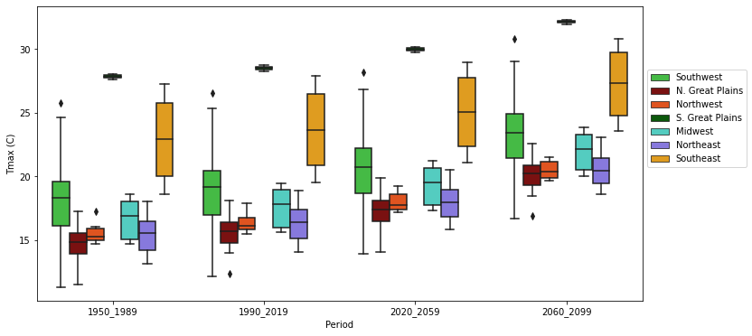
Annual Average Temperature: Regional Changes
RCP8.5 based forecast of Regional Daily Maximum Temperature changes
4th NCA Regional Map
Notes:
Variability within each region, and changes over time
Clearly temperature is increasing…

Slide 12
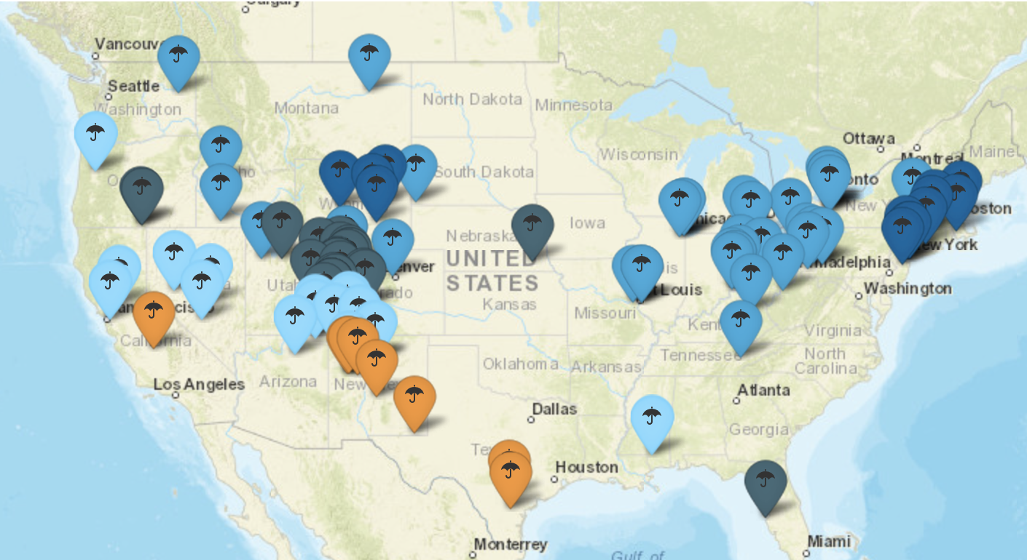
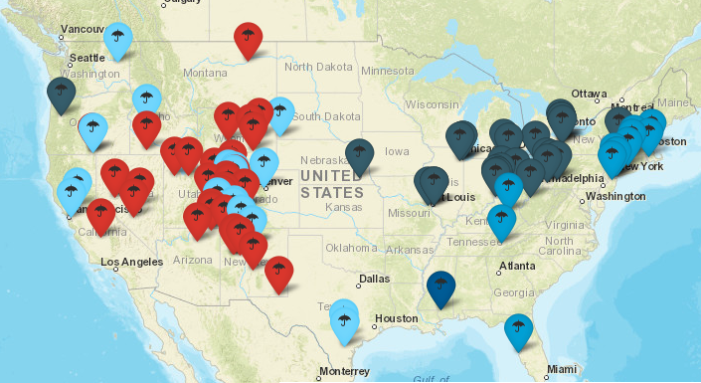
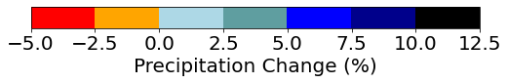
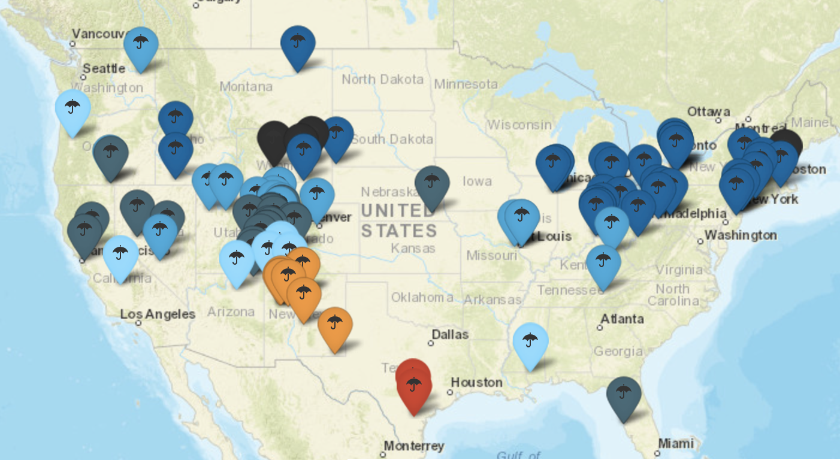
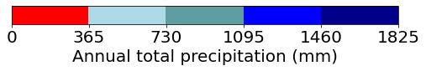
Annual Total Precipitation: All Sites
RCP4.5 (2007-2100)
RCP8.5 (2007-2100)
Average over the past 56 years (1950-2006)
Notes:
A few sites in NM, TX and CO are getting drier, northeast regions are projected to increase more significantly
Dry gets drier, wet gets wetter

Slide 13
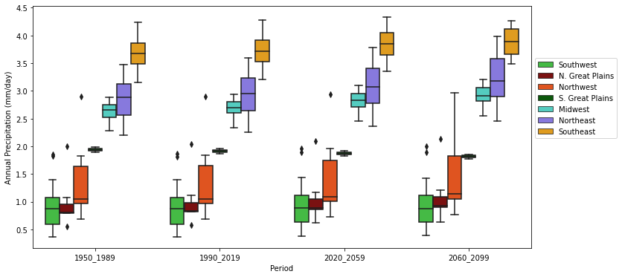
Annual Total Precipitation: Regional Changes
RCP8.5 based forecast of Annual Regional Precipitation changes
4th NCA Regional Map
Notes:
The changes are not significant at the regional distribution level

Slide 14
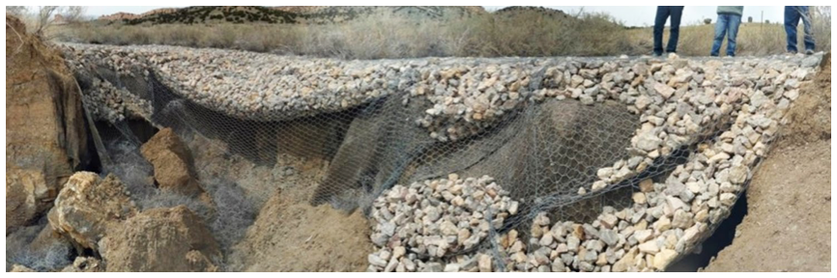
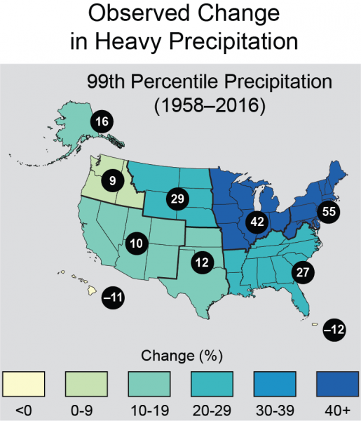
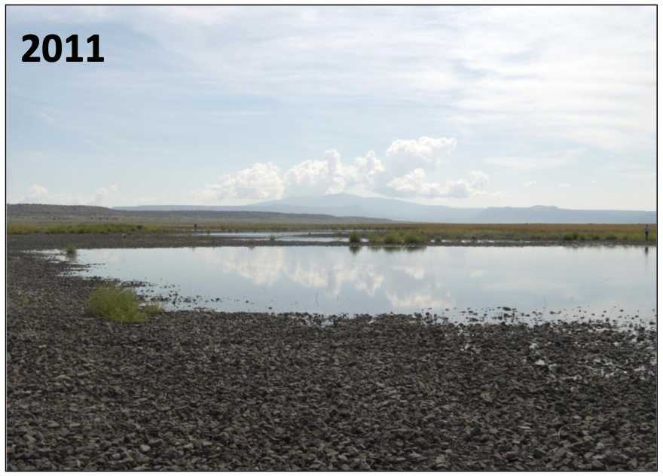
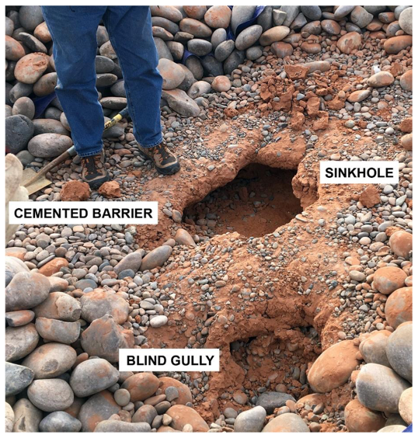
Extreme Precipitation
EPA definition: “Extreme precipitation events are defined as days with precipitation in the top 1% of all days having recordable precipitation.”
“Number of extreme precipitation days” is computed by counting precipitation greater than the threshold, set as 99th percentile of precipitation in the historical period.
L-Bar, NM
Bluewater, NM
Mexican Hat, UT
USGCRP Report: https://toolkit.climate.gov/image/2712
Notes:
Extreme precipitation could lead to flooding, erosion,

Slide 15
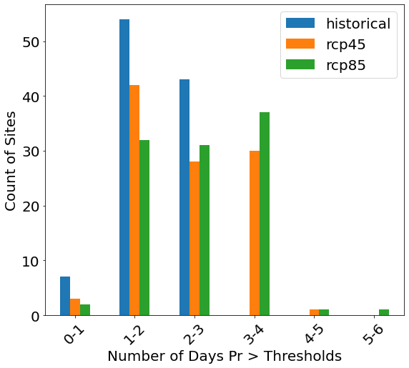
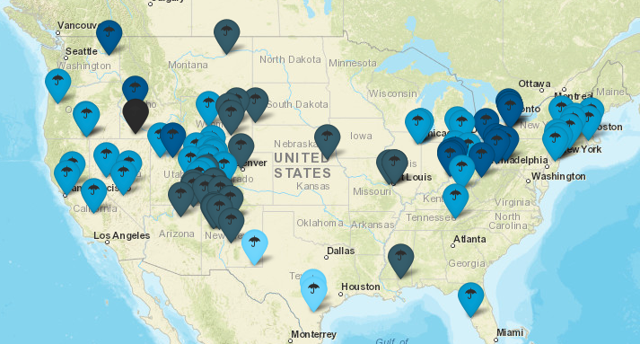
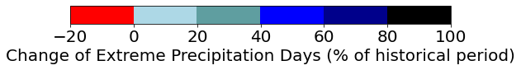
Extreme Precipitation Days: All Sites
Extreme precipitation days by EPA
# days with precipitation in the top 1% of all days with precipitation
RCP8.5 vs historical
Notes:
If you still remember the annual total precipitation plots in the previous two slides, you might recall that their changes is only 10-20%, while the change of extreme precipitation is greater than annual average precipitation…

Slide 16
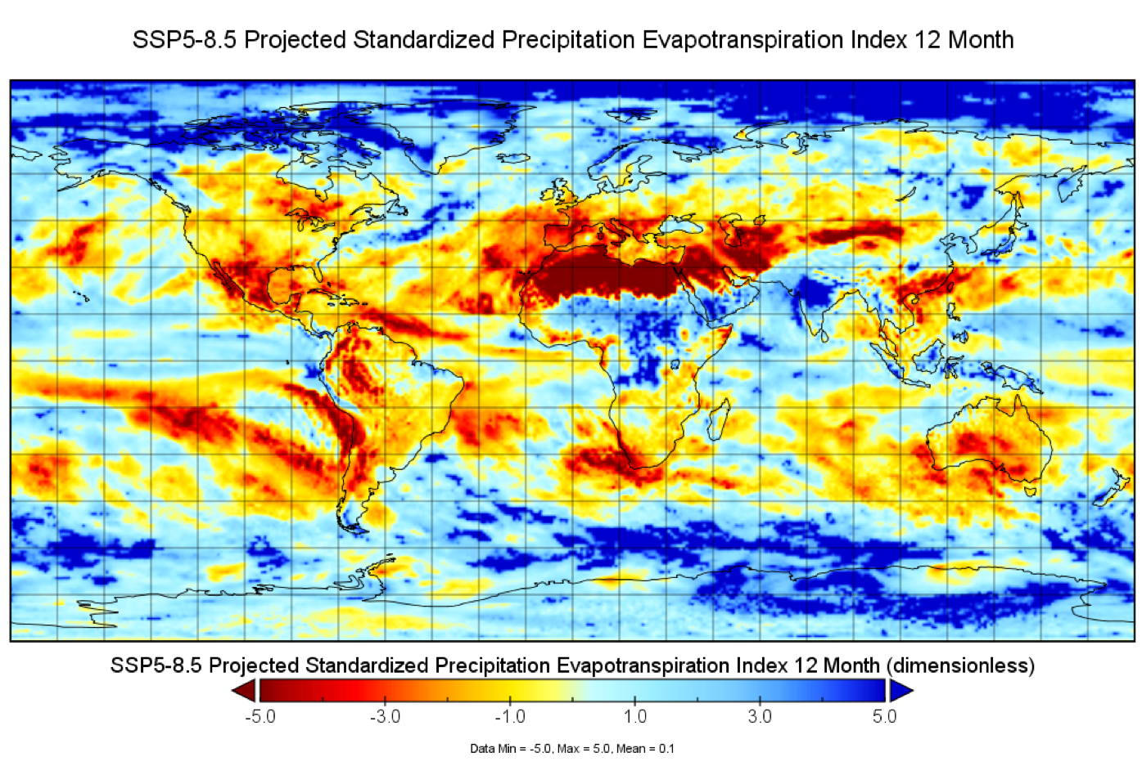
Drought Index
Standardized Precipitation-Evapotranspiration Index (SPEI)
Drought index to take into account both precipitation and potential evapotranspiration (PET) in determining drought
Based on long-term (>30 years) climatological information
Standardized and Dimensionless, negative values means drier
Global dataset from Araujo and Nikolopoulos, Florida Institute of Technology
Notes:
We also got a chance to evaluate the drought index, SPEI, which takse into account both…
Here, we used an external datasets from our collaborators,
By using this dataset, we also demonstrate that our tool has the capability to utilize and analyze external datasets

Slide 17
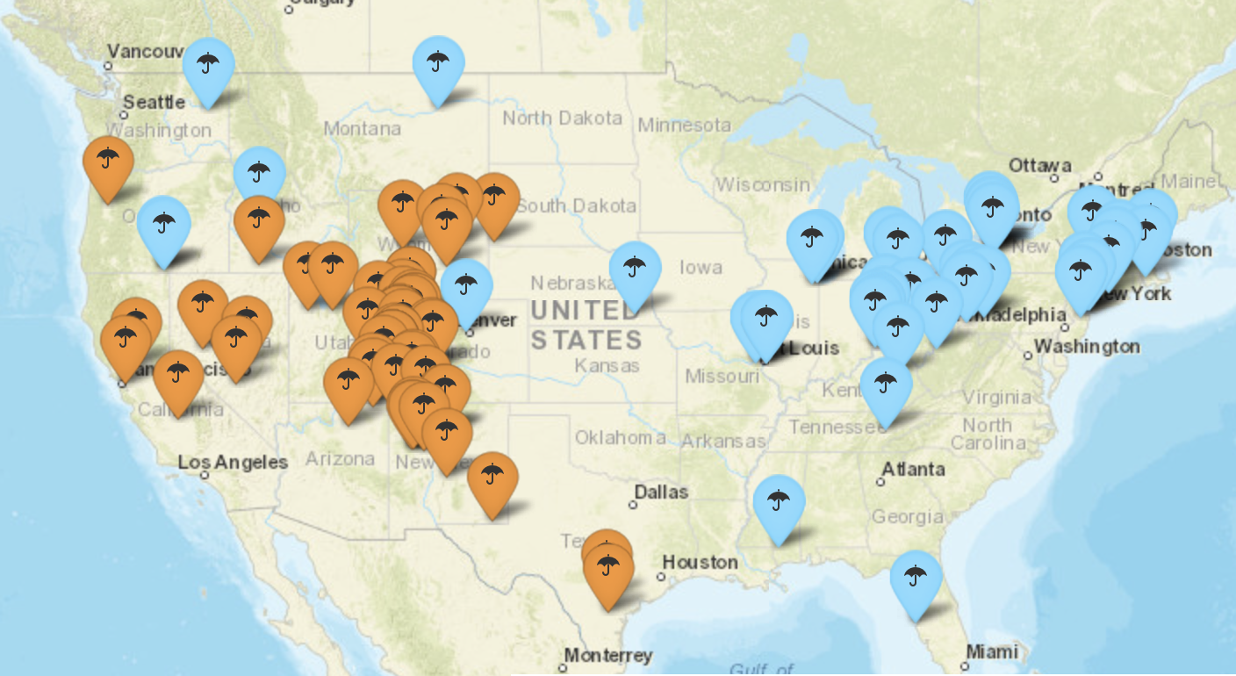
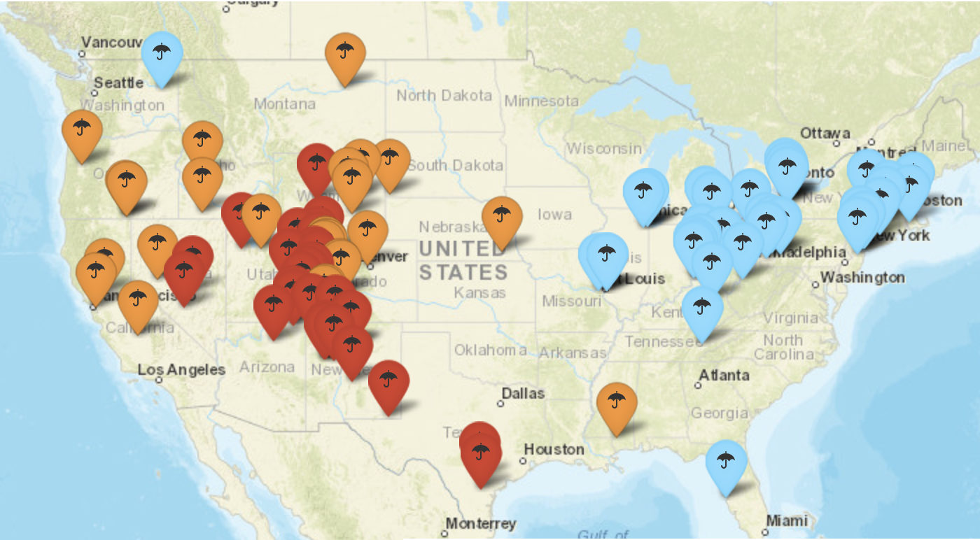
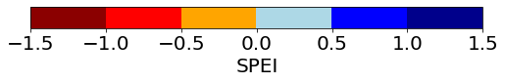
Annual Average SPEI: All Sites
Projected SPEI (2015-2100) based on historical climatological dataset (1981-2014)
RCP2.6 RCP8.5
Drier
Wetter
Notes:
Wetter in the northeast sites, and drier in the southwest sites
For SPEI, RCP8.5 is drier than RCP2.6
Dry gets drier, wet get wetter, …

Slide 18
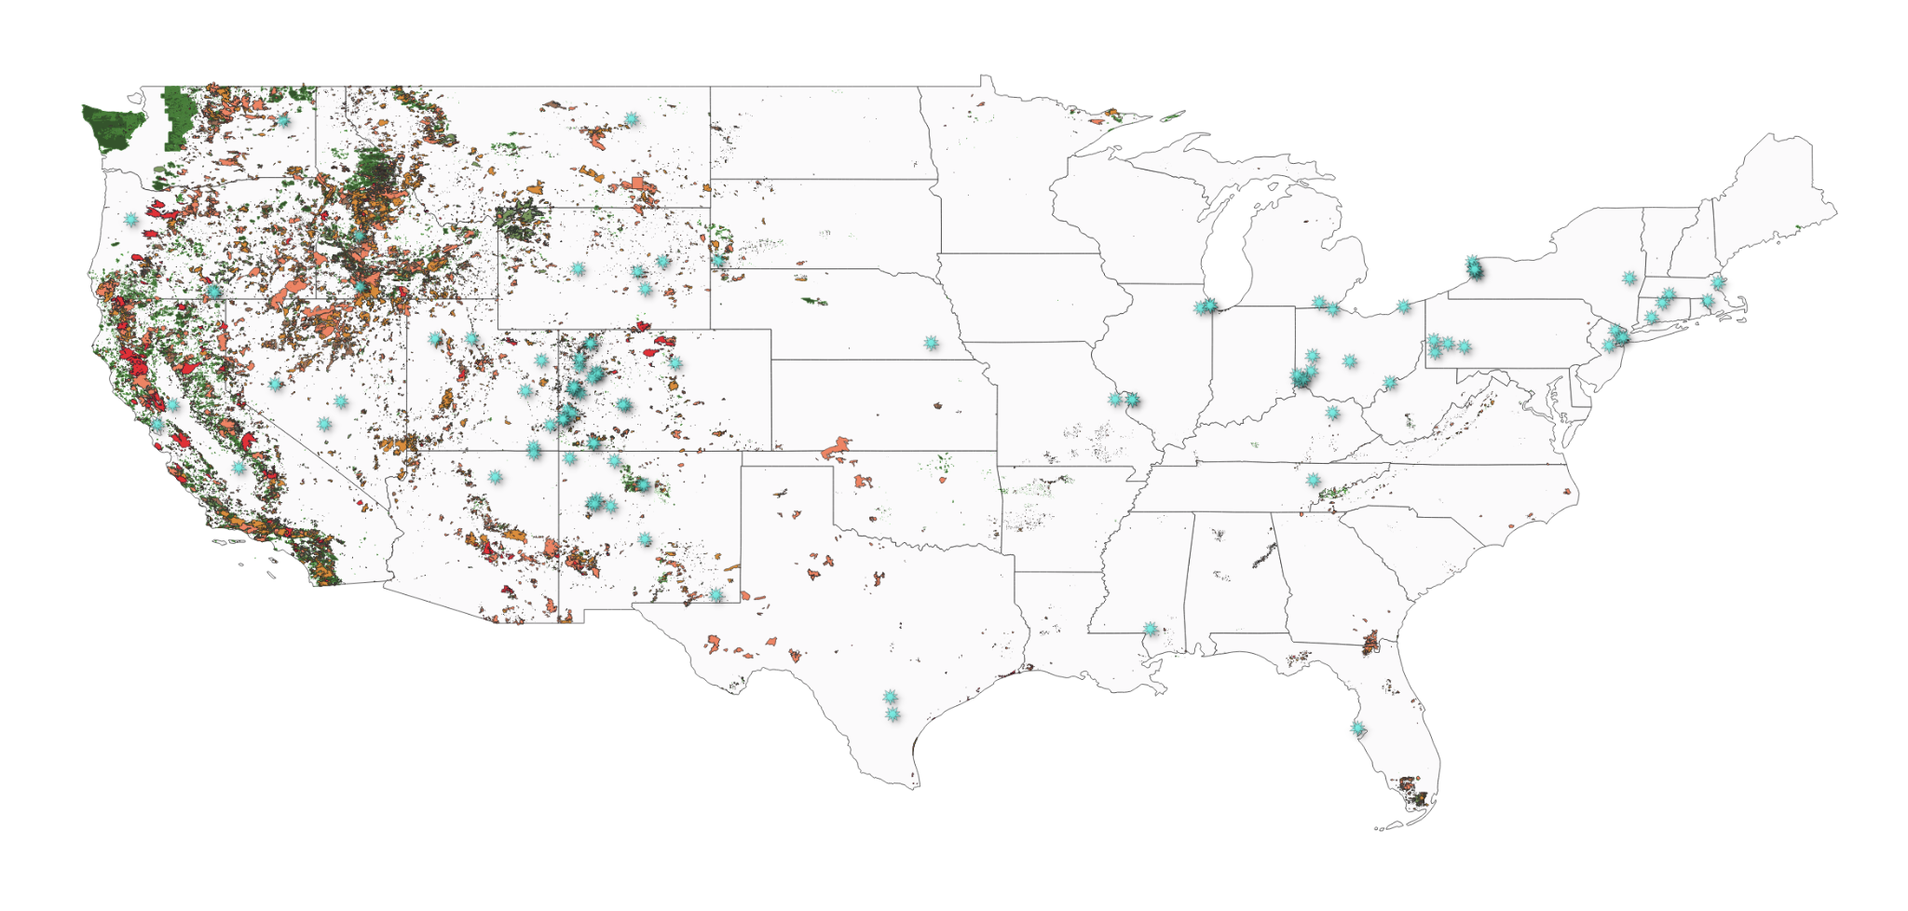

Wildfire frequency and area have increased over the last century
2020
2010-2019
2000-2009
1990-1999
1980-1989
1979 and prior
LM Sites

Slide 19
An example at Mexican Hat, UT
 | hist_mean | hist_std | recent_mean | rcp45_mean | rcp45_max | rcp85_mean | rcp85_max | risk_rcp45 | risk_rcp85
Annual precipitation (mm/day) | 0.54 | 0.03 | 0.54 | 0.58 | 0.71 | 0.57 | 0.7 | 1.07 | 0.83
Extreme precipitation day | 0.93 | 1.04 | 1.28 | 1.2 | 5.33 | 1.29 | 5.24 | 29% | 39%
Annual avg Tmax (C) | 20.96 | 0.39 | 21.76 | 23.46 | 25.39 | 24.54 | 27.95 | 6.36 | 9.09
Maximum Daily Precipitation (mm/day) | 20.25 | 9.1 | 20.15 | 21.95 | 56.84 | 22.32 | 58.63 | 9.5% | 11.3%
SPEI | -0.01 | 0.29 | -0.08 | N/A | N/A | -0.61 | -1.66 | N/A | -2.09
Risks of annual precipitation and Tmax are statistically computed by (scenarios_mean - historical_mean) / hist_std
Risks of extreme precipitation are computed by changes in percentage
Notes:
Our climate tool is also able to provide aggregated climate database for individual nuclear site, that we will hand off to site management and stakeholders
Here is an example of at …
With this dataset, we are able to quantify the risk index of each climate metrics by statistical calculation, …

Slide 20
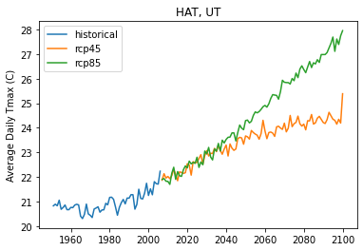
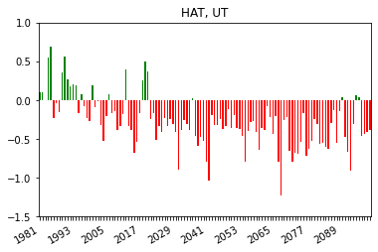
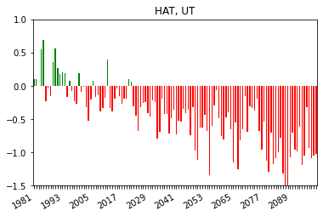
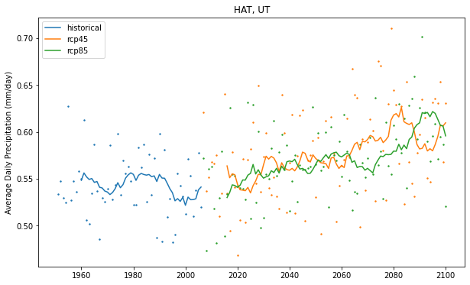
An example at Mexican Hat, UT
Annual average Tmax
Annual average precipitation
Drought Index RCP2.6
Drought Index RCP8.5
Notes:
Our tool is also able to generate different kinds of visualization for different climate variables, …
Scatterplot with moving average,
Barplots…

Slide 21
Summary
Downscaled CMIP5 projection data are used to support climate resilience assessment for nuclear waste sites
The python package/software was developed to automate climate data downloading, preprocessing and analytics
With institutional knowledges, the climate resilience package was used to assess climate risks of flood, drought, erosion, wildfire for DOE Legacy Management sites
This toolkit has been extended to support VARP at the DOE Environmental Management sites, and can be used for other sites/purposes

